Slide 1
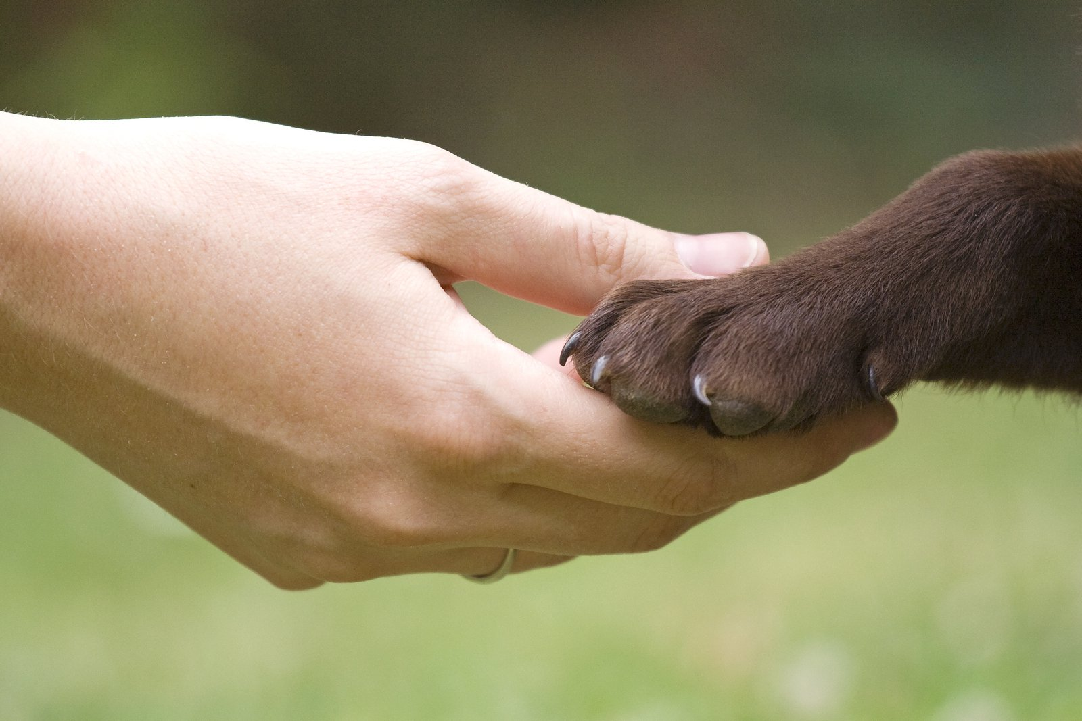

Animal Rights
Ethical Understanding
THIS POWERPOINT HAS BEEN PRODUCED BY MATTHEW WILLS FOR TEACHERS TO USE WITH THEIR STUDENTS. IT IS A CONDITION OF ITS USE THAT IT BE USED ONLY BY TEACHERS THAT HAVE PURCHASED THE PRESENTATION.
Email me at admin@socraticsolutionsaustralasia.com

Slide 2
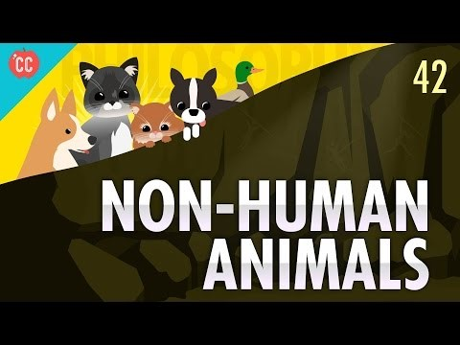
You Tube Video

Slide 3

Animal Rights
Animal rights is the idea in which some, or all, non-human animals are entitled to the possession of their own lives and that their most basic interests—such as the need to avoid suffering—should be afforded the same consideration as similar interests of human beings.
Notes:
Animal rights is the idea in which some, or all, non-human animals are entitled to the possession of their own lives and that their most basic interests—such as the need to avoid suffering—should be afforded the same consideration as similar interests of human beings

Slide 4
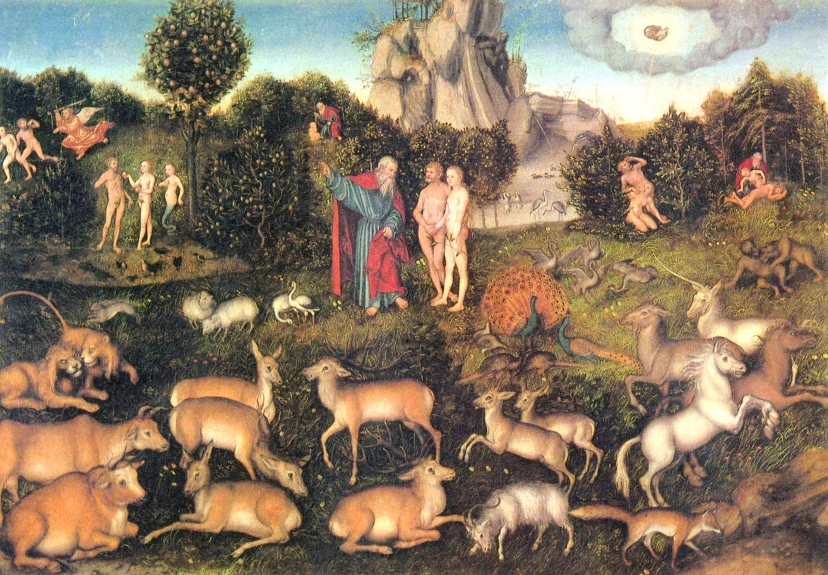
Animal rights
In the Book of Genesis 1:26, Adam is given "dominion over the fish of the sea, and over the fowl of the air, and over the cattle, and over all the earth, and over every creeping thing that creepeth upon the earth." Dominion need not entail property rights, but it has been interpreted, by some, over the centuries to imply ownership.
Notes:
Aristotle argued that animals lacked reason (logos), and placed humans at the top of the natural world, yet the respect for animals in ancient Greece was very high. Some animals were considered divine e.g.:dolphins. The 21st-century debates about animals can be traced back to the ancient world, and the idea of a divine hierarchy. In the Book of Genesis 1:26 (5th or 6th century BCE), Adam is given "dominion over the fish of the sea, and over the fowl of the air, and over the cattle, and over all the earth, and over every creeping thing that creepeth upon the earth." Dominion need not entail property rights, but it has been interpreted, by some, over the centuries to imply ownership.

Slide 5
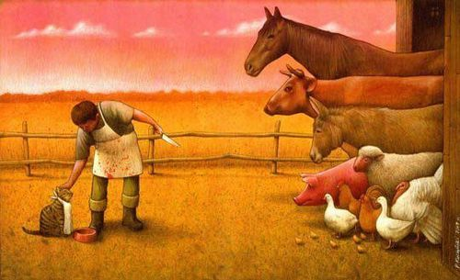
Animal rights
The two main philosophical approaches to animal rights are utilitarian and rights-based.
Notes:
The two main philosophical approaches to animal rights are utilitarian and rights-based. The former is exemplified by Peter Singer, and the latter by Tom Regan and Gary Francione. Their differences reflect a distinction philosophers draw between ethical theories that judge the rightness of an act by its consequences (consequentialism/teleological ethics, or utilitarianism), and those that focus on the principle behind the act, almost regardless of consequences (deontological ethics). Deontologists argue that there are acts we should never perform, even if failing to do so entails a worse outcome.

Slide 6
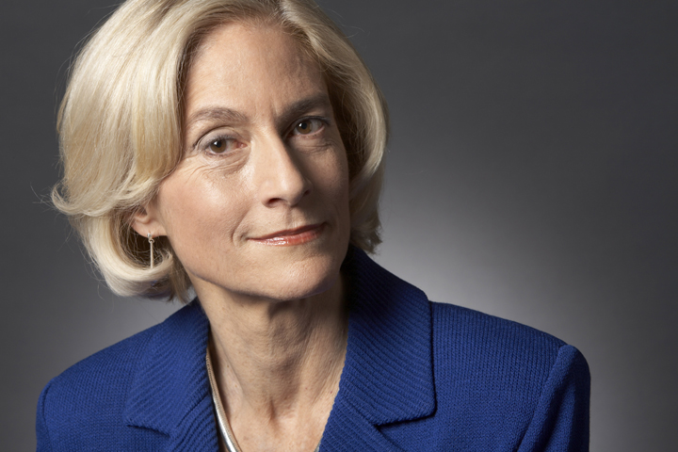
Animal Rights
The capabilities approach focuses on what individuals require to fulfil their capabilities.
Notes:
There are a number of positions that can be defended from a consequentalist or deontologist perspective, including the capabilities approach, represented by Martha Nussbaum, and the egalitarian approach, which has been examined by Ingmar Persson and Peter Vallentyne. The capabilities approach focuses on what individuals require to fulfill their capabilities: Nussbaum (2006) argues that animals need a right to life, some control over their environment, company, play, and physical health.

Slide 7
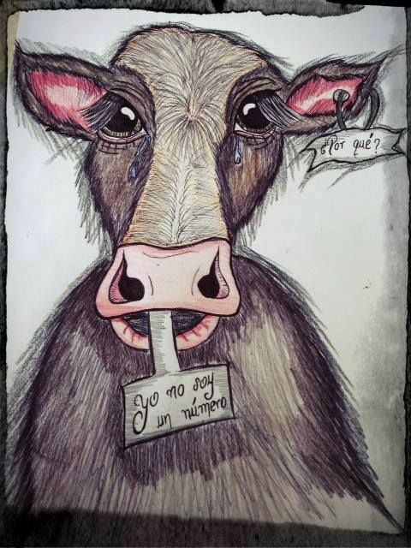
Animal Rights
Virtue ethics, holds that in considering how to act we should consider the character of the actor, and what kind of moral agents we should be.
Notes:
Stephen R. L. Clark, Mary Midgley, and Bernard Rollin also discuss animal rights in terms of animals being permitted to lead a life appropriate for their kind. Egalitarianism favours an equal distribution of happiness among all individuals, which makes the interests of the worse off more important than those of the better off. Another approach, virtue ethics, holds that in considering how to act we should consider the character of the actor, and what kind of moral agents we should be. Rosalind Hursthouse has suggested an approach to animal rights based on virtue ethics. Mark Rowlands has proposed a contractarian approach

Slide 8
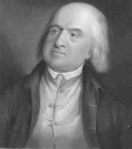
Utilitarianism
Martha Nussbaum writes that utilitarianism, starting with Jeremy Bentham and John Stuart Mill, has contributed more to the recognition of the moral status of animals than any other ethical theory.
Notes:
Nussbaum (2004) writes that utilitarianism, starting with Jeremy Bentham and John Stuart Mill, has contributed more to the recognition of the moral status of animals than any other ethical theory. The utilitarian philosopher most associated with animal rights is Peter Singer, professor of bioethics at Princeton University. Singer is not a rights theorist, but uses the language of rights to discuss how we ought to treat individuals. He is a preference utilitarian, meaning that he judges the rightness of an act by the extent to which it satisfies the preferences (interests) of those affected.

Slide 9
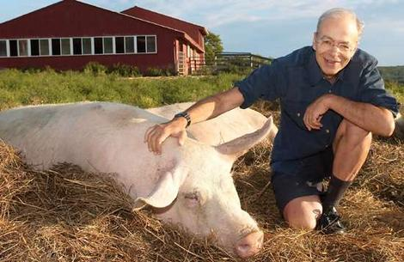
Utilitarianism
Peter Singers position is that there is no reason not to give equal consideration to the interests of human and nonhumans, though his principle of equality does not require identical treatment.
Notes:
Peter Singers position is that there is no reason not to give equal consideration to the interests of human and nonhumans, though his principle of equality does not require identical treatment. A mouse and a man both have an interest in not being kicked, and there are no moral or logical grounds for failing to accord those interests equal weight. Interests are predicated on the ability to suffer, nothing more, and once it is established that a being has interests, those interests must be given equal consideration. Singer quotes the English philosopher Henry Sidgwick (1838–1900): "The good of any one individual is of no more importance, from the point of view ... of the Universe, than the good of any other."

Slide 10

Utilitarianism
Singer argues that equality of consideration is a prescription, not an assertion of fact: if the equality of the sexes were based only on the idea that men and women were equally intelligent, we would have to abandon the practice of equal consideration if this were later found to be false.
Notes:
Singer argues that equality of consideration is a prescription, not an assertion of fact: if the equality of the sexes were based only on the idea that men and women were equally intelligent, we would have to abandon the practice of equal consideration if this were later found to be false. But the moral idea of equality does not depend on matters of fact such as intelligence, physical strength, or moral capacity. Equality therefore cannot be grounded on the outcome of scientific investigations into the intelligence of nonhumans. All that matters is whether they can suffer.

Slide 11
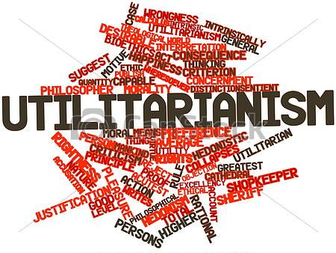
Utilitarianism
Commentators on all sides of the debate now accept that animals suffer and feel pain, although it was not always so.
Notes:
Commentators on all sides of the debate now accept that animals suffer and feel pain, although it was not always so. Bernard Rollin, professor of philosophy, animal sciences, and biomedical sciences at Colorado State University, writes that Descartes' influence continued to be felt until the 1980s. Veterinarians trained in the US before 1989 were taught to ignore pain, he writes, and at least one major veterinary hospital in the 1960s did not stock narcotic analgesics for animal pain control. In his interactions with scientists, he was often asked to "prove" that animals are conscious, and to provide "scientifically acceptable" evidence that they could feel pain.

Slide 12
Utilitarianism
Scientific publications have made it clear since the 1980s that the majority of researchers do believe animals suffer and feel pain, though it continues to be argued that their suffering may be reduced by an inability to experience the same dread of anticipation as humans, or to remember the suffering as vividly.
Notes:
Scientific publications have made it clear since the 1980s that the majority of researchers do believe animals suffer and feel pain, though it continues to be argued that their suffering may be reduced by an inability to experience the same dread of anticipation as humans, or to remember the suffering as vividly. The problem of animal suffering, and animal consciousness in general, arose primarily because it was argued that animals have no language. Singer writes that, if language were needed to communicate pain, it would often be impossible to know when humans are in pain, though we can observe pain behavior and make a calculated guess based on it. He argues that there is no reason to suppose that the pain behavior of nonhumans would have a different meaning from the pain behaviour of humans.

Slide 13
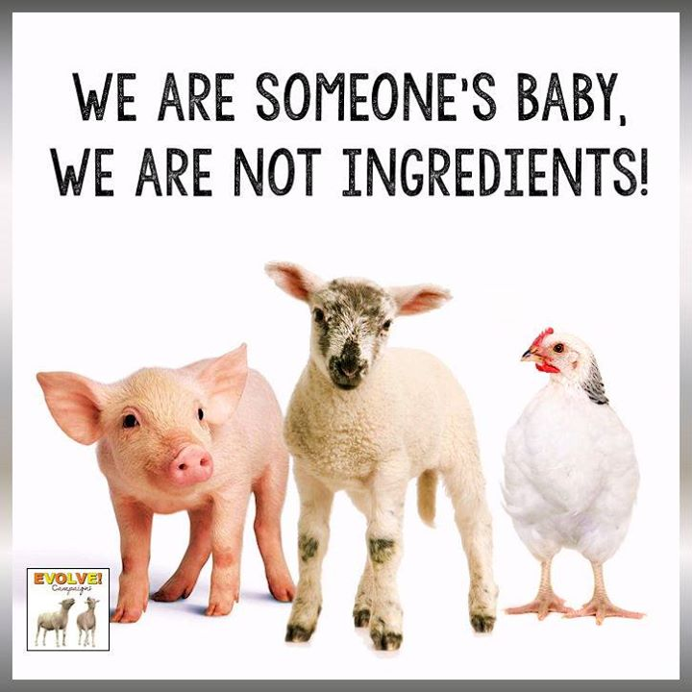
Subjects-of-a-life
Tom Regan, professor emeritus of philosophy at North Carolina State University, argues in The Case for Animal Rights(1983) that nonhuman animals are what he calls "subjects-of-a-life", and as such are bearers of rights.
Notes:
Tom Regan, professor emeritus of philosophy at North Carolina State University, argues in The Case for Animal Rights(1983) that nonhuman animals are what he calls "subjects-of-a-life", and as such are bearers of rights. He writes that, because the moral rights of humans are based on their possession of certain cognitive abilities, and because these abilities are also possessed by at least some nonhuman animals, such animals must have the same moral rights as humans. Although only humans act as moral agents, both marginal-case humans, such as infants, and at least some nonhumans must have the status of "moral patients"

Slide 14
Subjects-of-a-life
Only moral agents are able to engage in moral action. Animals for Regan have "intrinsic value" as subjects-of-a-life, and cannot be regarded as a means to an end.
Notes:
Moral patients are unable to formulate moral principles, and as such are unable to do right or wrong, even though what they do may be beneficial or harmful. Only moral agents are able to engage in moral action. Animals for Regan have "intrinsic value" as subjects-of-a-life, and cannot be regarded as a means to an end, a view that places him firmly in the abolitionist camp. His theory does not extend to all animals, but only to those that can be regarded as subjects-of-a-life. He argues that all normal mammals of at least one year of age would qualify:
“... individuals are subjects-of-a-life if they have beliefs and desires; perception, memory, and a sense of the future, including their own future; an emotional life together with feelings of pleasure and pain; preference- and welfare-interests; the ability to initiate action in pursuit of their desires and goals; a psychophysical identity over time; and an individual welfare in the sense that their experiential life fares well or ill for them, logically independently of their utility for others and logically independently of their being the object of anyone else's interests.”

Slide 15
Subjects-of-a-life
The Kantian ideal (which Kant himself applied only to humans) is that animals ought never to be sacrificed as a means to an end, and must be treated as ends in themselves.
Notes:
Whereas Singer is primarily concerned with improving the treatment of animals and accepts that, in some hypothetical scenarios, individual animals might be used legitimately to further human or nonhuman ends, Regan believes we ought to treat nonhuman animals as we would humans. He applies the strict Kantian ideal (which Kant himself applied only to humans) that they ought never to be sacrificed as a means to an end, and must be treated as ends in themselves.

Slide 16
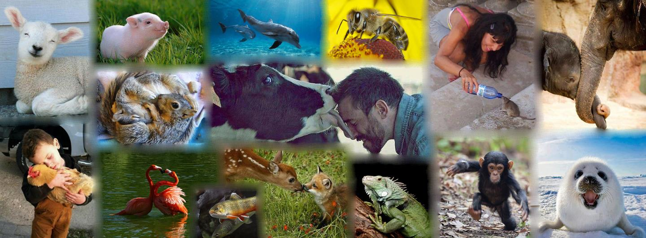
Abolitionism
Gary Francione, professor of law and philosophy at Rutgers Law School in Newark, is a leading abolitionist writer, arguing that animals need only one right, the right not to be owned.
Notes:
Abolitionism
Gary Francione, professor of law and philosophy at Rutgers Law School in Newark, is a leading abolitionist writer, arguing that animals need only one right, the right not to be owned. Everything else would follow from that paradigm shift. He writes that, although most people would condemn the mistreatment of animals, and in many countries there are laws that seem to reflect those concerns, "in practice the legal system allows any use of animals, however abhorrent." The law only requires that any suffering not be "unnecessary". In deciding what counts as "unnecessary", an animal's interests are weighed against the interests of human beings, and the latter almost always prevail.
Francione's Animals, Property, and the Law (1995) was the first extensive jurisprudential treatment of animal rights. In it, Francione compares the situation of animals to the treatment of slaves in the United States, where legislation existed that appeared to protect them, while the courts ignored that the institution of slavery itself rendered the protection unenforceable. He offers as an example the United States Animal Welfare Act, which he describes as an example of symbolic legislation, intended to assuage public concern about the treatment of animals, but difficult to implement.
He argues that a focus on animal welfare, rather than animal rights, may worsen the position of animals by making the public feel comfortable about using them and entrenching the view of them as property. He calls animal rights groups who pursue animal welfare issues, such as People for the Ethical Treatment of Animals, the "new welfarists", arguing that they have more in common with 19th-century animal protectionists than with the animal rights movement; indeed, the terms "animal protection" and "protectionism" are increasingly favoured. His position in 1996 was that there is no animal rights movement in the United States.

Slide 17
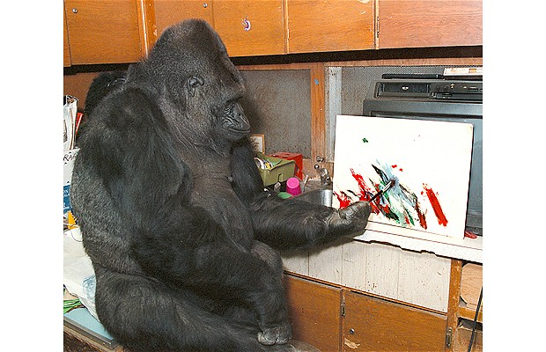
Contractarianism
Mark Rowlands, professor of philosophy at the University of Florida, has proposed a contractarian approach, based on the original position and the veil of ignorance—a "state of nature" thought experiment that tests intuitions about justice and fairness—in John Rawls's A Theory of Justice (1971).
Notes:
Mark Rowlands, professor of philosophy at the University of Florida, has proposed a contractarian approach, based on the original position and the veil of ignorance—a "state of nature" thought experiment that tests intuitions about justice and fairness—in John Rawls's A Theory of Justice (1971). In the original position, individuals choose principles of justice (what kind of society to form, and how primary social goods will be distributed), unaware of their individual characteristics—their race, sex, class, or intelligence, whether they are able-bodied or disabled, rich or poor—and therefore unaware of which role they will assume in the society they are about to form.
The idea is that, operating behind the veil of ignorance, they will choose a social contract in which there is basic fairness and justice for them no matter the position they occupy. Rawls did not include species membership as one of the attributes hidden from the decision makers in the original position. Rowlands proposes extending the veil of ignorance to include rationality, which he argues is an undeserved property similar to characteristics including race, sex and intelligence.

Slide 18

Prima facie rights theory
American philosopher Timothy Garry suggests that humans have obligations to nonhuman animals; however, animals do not, and ought not to, have uninfringible rights against humans.
Notes:
Prima facie rights theory
American philosopher Timothy Garry has proposed an approach that deems nonhuman animals worthy of prima facie rights. In a philosophical context, a prima facie (Latin for "on the face of it" or "at first glance") right is one that appears to be applicable at first glance, but upon closer examination may be outweighed by other considerations. In his book Ethics: A Pluralistic Approach to Moral Theory, Lawrence Hinman characterizes such rights as "the right is real but leaves open the question of whether it is applicable and overriding in a particular situation". The idea that nonhuman animals are worthy of prima facie rights is to say that, in a sense, animals do have rights. However, these rights can be overridden by many other considerations, especially those conflicting a human's right to life, liberty, property, and the pursuit of happiness. Garry supports his view arguing:
... if a nonhuman animal were to kill a human being in the U.S., it would have broken the laws of the land and would probably get rougher sanctions than if it were a human. My point is that like laws govern all who interact within a society, rights are to be applied to all beings who interact within that society. This is not to say these rights endowed by humans are equivalent to those held by nonhuman animals, but rather that if humans possess rights then so must all those who interact with humans.
In sum, Garry suggests that humans have obligations to nonhuman animals; however, animals do not, and ought not to, have uninfringible rights against humans.

Slide 19
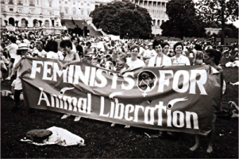
Feminism and animal rights
Women have played a central role in animal advocacy since the 19th century.
Notes:
Women have played a central role in animal advocacy since the 19th century. The anti-vivisection movement in the 19th and early 20th century in England and the United States was largely run by women, including Francis Power Cobbe, Anna Kingsford, Lizzy Lind af Hageby and Caroline Earle White (1833–1916). Garner writes that 70 per cent of the membership of the Victoria Street Society (one of the anti-vivisection groups founded by Cobbe) were women, as were 70 per cent of the membership of the British RSPCA in 1900.

Slide 20
Feminism and animal rights
The modern animal advocacy movement has a similar representation of women and several influential animal advocacy groups have been founded by women.
Notes:
The modern animal advocacy movement has a similar representation of women, though Garner (2005) writes that they are not invariably in leadership positions: during the March for Animals in Washington, D.C., in 1990—the largest animal rights demonstration held until then in the United States—most of the participants were women, but most of the platform speakers were men. Nevertheless, several influential animal advocacy groups have been founded by women, including the British Union for the Abolition of Vivisection by Cobbe in London in 1898; the Animal Welfare Board of India by Rukmini Devi Arundale in 1962; and People for the Ethical Treatment of Animals, co-founded by Ingrid Newkirk in 1980. In the Netherlands, Marianne Thieme and Esther Ouwehand were elected to parliament in 2006 representing the Parliamentary group for Animals.

Slide 21
Feminism and animal rights
The many women in the animal rights movement has led to a body of academic literature exploring feminism and animal rights; feminism and vegetarianism or veganism, the oppression of women and animals, and the male association of women and animals with nature and emotion, rather than reason—an association that several feminist writers have embraced.
Notes:
The many women in the movement has led to a body of academic literature exploring feminism and animal rights; feminism and vegetarianism or veganism, the oppression of women and animals, and the male association of women and animals with nature and emotion, rather than reason—an association that several feminist writers have embraced. Lori Gruen writes that women and animals serve the same symbolic function in a patriarchal society: both are "the used"; the dominated, submissive "Other". When the British feminist Mary Wollstonecraft(1759–1797) published A Vindication of the Rights of Woman (1792), Thomas Taylor (1758–1835), a Cambridge philosopher, responded with an anonymous parody, A Vindication of the Rights of Brutes (1792), claiming that Wollstonecraft's arguments for women's rights could be applied equally to animals, a position he intended as reductio ad absurdum.

Slide 22

Transhumanismm
Some transhumanists argue for animal rights, liberation, and "uplift" of animal consciousness into machines.
Notes:
Transhumanism
Some transhumanists argue for animal rights, liberation, and "uplift" of animal consciousness into machines. Transhumanism also understands animal rights on a gradation or spectrum with other types of sentient rights, including human rights and the rights of conscious artificial intelligences (posthuman rights)

Slide 23
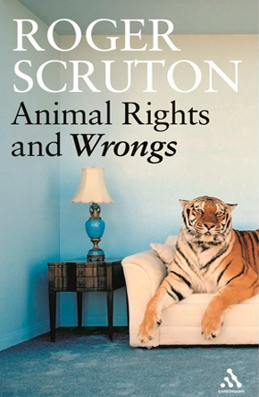
Critics
Critics of animal rights argue that nonhuman animals are unable to enter into a social contract, and thus cannot be possessors of rights, a view summed up by the philosopher Roger Scruton, who writes that only humans have duties, and therefore only humans have rights.
Notes:
Critics of animal rights argue that nonhuman animals are unable to enter into a social contract, and thus cannot be possessors of rights, a view summed up by the philosopher Roger Scruton, who writes that only humans have duties, and therefore only humans have rights. Another argument, associated with the utilitarian tradition, is that animals may be used as resources so long as there is no unnecessary suffering; they may have some moral standing, but they are inferior in status to human beings, and any interests they have may be overridden, though what counts as "necessary" suffering or a legitimate sacrifice of interests varies considerably. Certain forms of animal rights activism, such as the destruction of fur farms and animal laboratories by the Animal Liberation Front, have also attracted criticism, including from within the animal rights movement itself, as well as prompted reaction from the U.S. Congress with the enactment of laws allowing these activities to be prosecuted as terrorism, including the Animal Enterprise Terrorism Act.

Slide 24
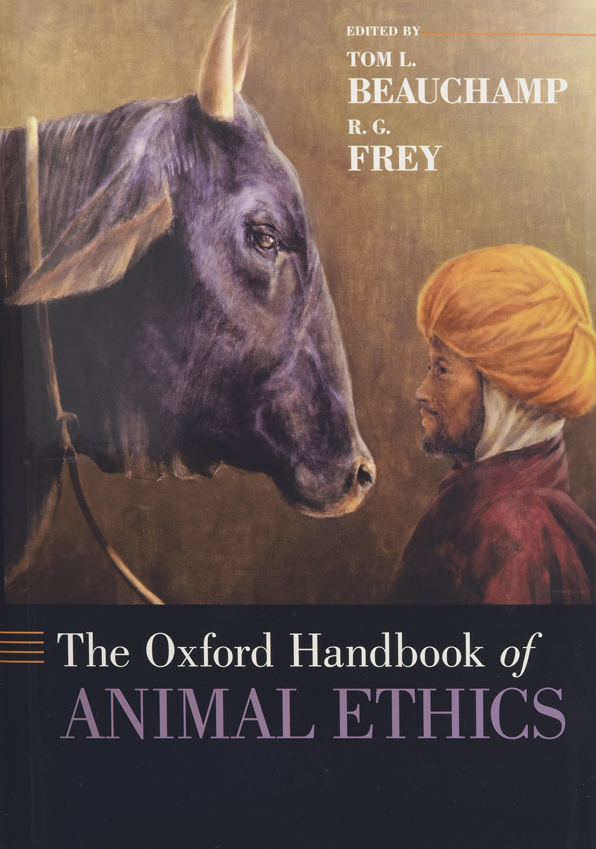
Critics
R. G. Frey
R. G. Frey, professor of philosophy at Bowling Green State University, is a preference utilitarian, as is Singer, but reaches a very different conclusion, arguing in Interests and Rights (1980) that animals have no interests for the utilitarian to take into account.
Notes:
R. G. Frey
R. G. Frey, professor of philosophy at Bowling Green State University, is a preference utilitarian, as is Singer, but reaches a very different conclusion, arguing in Interests and Rights (1980) that animals have no interests for the utilitarian to take into account. Frey argues that interests are dependent on desire, and that no desire can exist without a corresponding belief. Animals have no beliefs, because a belief state requires the ability to hold a second-order belief—a belief about the belief—which he argues requires language: "If someone were to say, e.g. 'The cat believes that the door is locked,' then that person is holding, as I see it, that the cat holds the declarative sentence 'The door is locked' to be true; and I can see no reason whatever for crediting the cat or any other creature which lacks language, including human infants, with entertaining declarative sentences."

Slide 25
Critics
Roger Scruton, the British philosopher, argues that rights imply obligations. Every legal privilege, he writes, imposes a burden on the one who does not possess that privilege: that is, "your right may be my duty."
Notes:
Roger Scruton
Roger Scruton, the British philosopher, argues that rights imply obligations. Every legal privilege, he writes, imposes a burden on the one who does not possess that privilege: that is, "your right may be my duty." Scruton therefore regards the emergence of the animal rights movement as "the strangest cultural shift within the liberal worldview", because the idea of rights and responsibilities is, he argues, distinctive to the human condition, and it makes no sense to spread them beyond our own species.
He accuses animal rights advocates of "pre-scientific" anthropomorphism, attributing traits to animals that are, he says, Beatrix Potter-like, where "only man is vile." It is within this fiction that the appeal of animal rights lies, he argues. The world of animals is non-judgmental, filled with dogs who return our affection almost no matter what we do to them, and cats who pretend to be affectionate when, in fact, they care only about themselves. It is, he argues, a fantasy, a world of escape

Slide 26
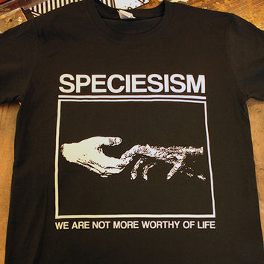
Animal Rights
Advocates oppose the assignment of moral value and fundamental protections on the basis of species membership alone—an idea known since 1970 as speciesism.
Notes:
Advocates oppose the assignment of moral value and fundamental protections on the basis of species membership alone—an idea known since 1970 as speciesism, when the term was coined by Richard D. Ryder—arguing that it is a prejudice as irrational as any other. They maintain that animals should no longer be viewed as property or used as food, clothing, research subjects, entertainment, or beasts of burden. Multiple cultural traditions around the world—such as Animism, Taoism, Hinduism, Buddhism, and Jainism—also espouse some forms of animal rights.

Slide 27
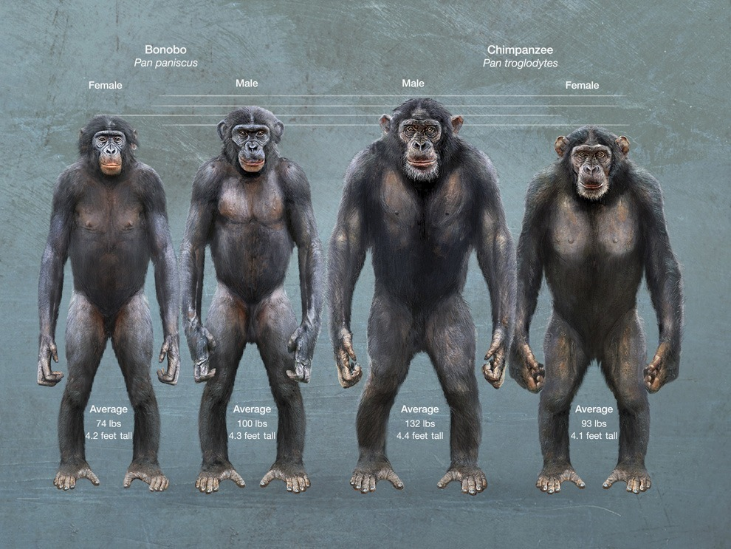
Animal Rights
The animals most often considered in arguments for personhood are bonobos and chimpanzees because these are most likely to break through the species barrier.
Notes:
In parallel to the debate about moral rights, animal law is now widely taught in law schools in North America, and several prominent legal scholars support the extension of basic legal rights and personhood to at least some animals. The animals most often considered in arguments for personhood are bonobos and chimpanzees. This is supported by some animal rights academics because it would break through the species barrier, but opposed by others because it predicates moral value on mental complexity, rather than on sentience alone.

Slide 28
Bibliography
Adams, Carol J. (1996). The Sexual Politics of Meat: A Feminist-Vegetarian Critical Theory. Continuum. and Josephine, Donovan (eds.) (1995). Animals and Women: Feminist Theoretical Explorations. Duke University Press. (2004). The Pornography of Meat. Continuum.
Arluke, Arnold and Sax, Boria (1992). "Understanding Nazi Animal Protection and the Holocaust", Anthrozoos: A Multidisciplinary Journal of The Interactions of People & Animals, Volume 5, Number 1, 1992, pp. 6–31(26).
Benthall, Jonathan (2007). "Animal liberation and rights", Anthropology Today, volume 23, issue 2, April.
Bentham, Jeremy (1781). Principles of Penal Law.
Beauchamp, Tom (2009). "The Moral Standing of Animals", in Marc Bekoff. Encyclopedia of Animal Rights and Animal Welfare. Greenwood. (2011a). "Introduction," in Tom Beauchamp and R.G. Frey (eds.). The Oxford Handbook of Animal Ethics. Oxford University Press. (2011b). "Rights Theory and Animal Rights," in Beauchamp and Frey, op cit.
Clark, Stephen R. L. (1977). The Moral Status of Animals. Oxford University Press.
Cohen, Carl (1986). "The Case for the Use of Animals in Biomedical Research", New England Journal of Medicine, vol. 315, issue 14, October, pp. 865–870.
Cohen, Carl and Regan, Tom (2001). The Animal Rights Debate. Rowman & Littlefield.
Cottingham, John (1995). "Descartes, René" in Honderich, Ted. (ed.) The Oxford Companion to Philosophy. Oxford University Press.
Craig, Edward (ed.) (1988). "Deontological Ethics" and "Consequentalism," Routledge Encyclopedia of Philosophy.
Donovan, Josephine (1993). "Animal Rights and Feminist Theory," in Greta Gaard. Ecofeminism: Women, Animals, Nature. Temple University Press.
Francione, Gary (1996). Rain Without Thunder: The Ideology of the Animal Rights Movement. Temple University Press. (1995). Animals, Property, and the Law. Temple University Press.
of Books, vol 50, no. 8, May 15. (2004). "Ethics Beyond Species and BeyonScruton, Roger (1998). Animal Rights and Wrongs. Claridge Press. (2000). "Animal Rights", City Journal, summer.
  Singer, Peter (April 5, 1973). "Animal liberation", The New York Review of Books, Volume 20, Number 5.(1990) [1975]. Animal Liberation. New York Review Books. (2000) [1998]. Ethics into Action: Henry Spira and the Animal Rights Movement. Rowman and Littlefield Publishers, Inc. (2003). "Animal liberation at 30 The New York Review d Instincts," in Sunstein and Nussbaum, op cit. (2011) [1979]. Practical Ethics. Cambridge University Press.
  Sorabji, Richard (1993). Animal Minds and Human Morals. University of Cornell Press.
  Sprigge, T.L.S. (1981) "Interests and Rights: The Case against Animals", Journal of Medical Ethics. June, 7(2): 95–102.
  Stamp Dawkins, Marian (1980). Animal Suffering: The Science of Animal Welfare. Chapman and Hall.
  Steiner, Gary (2005). Anthropocentrism and its Discontents: The Moral Status of Animals in the History of Western Philosophy. University of Pittsburgh Press.
  Sunstein, Cass R. (2004). "Introduction: What are Animal Rights?" in Sunstein and Nussbaum, op cit.
  Taylor, Angus (2009). Animals and Ethics: An Overview of the Philosophical Debate. Broadview Press.
  Thomas Taylor (1792). "A Vindication of the Rights of Brutes," in Craciun, Adriana (2002). A Routledge Literary Sourcebook on Mary Wollstonecraft's A Vindication of the Rights of Woman. Routledge.
  Uekoetter, Frank (2006). The Green and the Brown: A History of Conservation in Nazi Germany. Cambridge University Press.
  Vallentyne, Peter (2005). "Of Mice and Men: Equality and Animals", The Journal of Ethics, Vol. 9, No. 3/4, pp. 403–433. (2007). "Of Mice and Men: Equality and Animals" in Nils Holtug, and Kasper Lippert-Rasmussen (eds.) (2007). Egalitarianism: New Essays on the Nature and Value of Equality. Oxford University Press.
  Vyvyan, John (1969). In Pity and in Anger. M. Joseph.
  Waldau, Paul (2001). The Specter of Speciesism: Buddhist and Christian Views of Animals. Oxford University Press.
  Waldau, Paul (2011). Animal Rights: What Everyone Needs to Know. Oxford University Press.
  Walker, Stephen (1983). Animal Thoughts. Routledge.
  Ward, Nathaniel (1896). The Earliest New England Code of Laws, 1641. A. Lovell & Company.
  Weir, Jack (2009). "Virtue Ethics," in Marc Bekoff. Encyclopedia of Animal Rights and Animal Welfare. Greenwood.
  Wikipedia: https://en.wikipedia.org/wiki/Animal_rights
  Williams, Erin E. and DeMello, Margo (2007). Why Animals Matter. Prometheus Books.
  Wise, Steven M (2000). Rattling the Cage: Toward Legal Rights for Animals. Da Capo Press.

